Slide 1


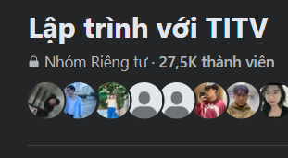






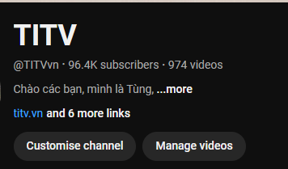

Le Nhat Tung – Email: lenhattung@gmail.com
Master in
Information systems
Master in Data science
and business analytics

